Slide 1
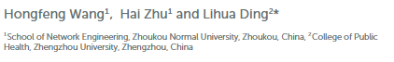
Accurate Classification of Lung Nodule on CT Images Using the TransUnet
Keywords:
Lung cancer,
Computed tomography,
Lung nodule classification,
Deep convolutional neural networks,
LIDI-IDRI
2022 Frontiers in Public Health
Student: 顏安利 V1B4
Advisor: 連震杰 教授
Co-Advisor: 顏亦廷 主任醫師 兼副教授
Co-Advisor: 張超群 主治醫師 兼助理教授
Robotics Lab, CSIE NCKU
Edited date: 2024/12/26

Slide 2
Content
1. Introduction
1.1 Motivation, Objective and Global Framework
1.2 Related Works
1.3 Contribution
2. System Setup and Functions
2.1 System Setup
2.2 Function Specifications
3. Frameworks
3.1 Training and Inference Framework
3.1.1 Training Framework
3.1.2 Inference Framework
3.1.3 Loss Function
3.2 Multi-Head Self-Attention (MHSA)
3.3 Global Average Pooling (GAP)
4. Experimental Results
4.1 Data Collection and Evaluation Metrics
4.1.1 Data Collection
4.1.2 Evaluation Metrics
4.2 Experiment Results
4.3 Ablation Study
5. Discussion and Conclusion
5.1 Discussion
5.2 Conclusion
R. Reference

Slide 3
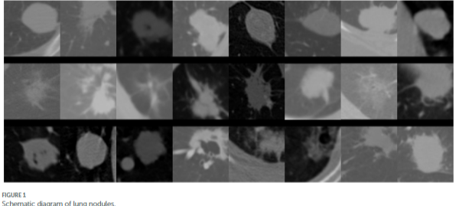
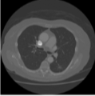
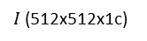
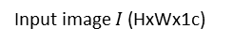
1.1 Introduction: Motivation, Objective and Global Framework
1. Motivation
Assisting clinicians in making accurate decisions regarding lung cancer diagnosis, which is a critical area of research.
Utilizing transformer method to capture abstract features and improve classification accuracy.
2. Objective
Develop a novel DCNN method, named TransUnet, for automatic classification of pulmonary nodules in CT images as benign or malignant.
Enhance diagnostic precision by effectively classifying CT images.
Address challenges related to imbalanced datasets in medical imaging, which can affect the performance of traditional classification methods.
Input image $I$ (HxWx1c)
$I$ (512x512x1c)
Schematic diagram of lung nodules.
Example of patches of lung nodules found in CT images. CT images are downsampled to smaller feature maps and then tokenized (e.g. 1x1x256c).
3 to 30 mm nodule size
(0.5mm/pixel)→(6x6x1c to 60x60x1c of 512x512x1c)

Slide 4
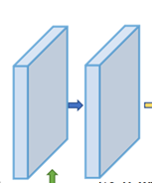
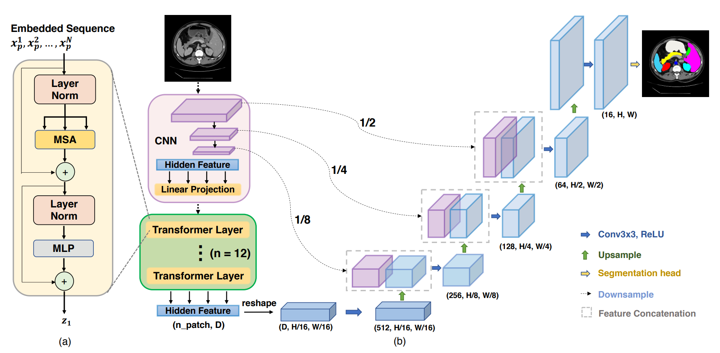
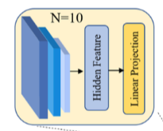
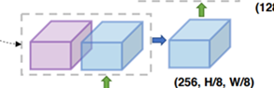
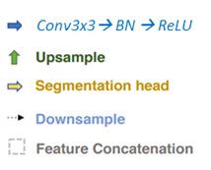
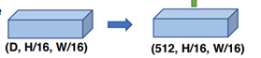
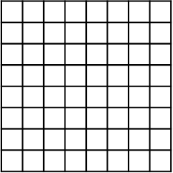

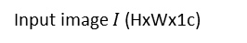
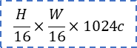
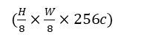
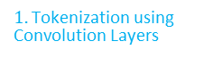
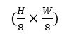
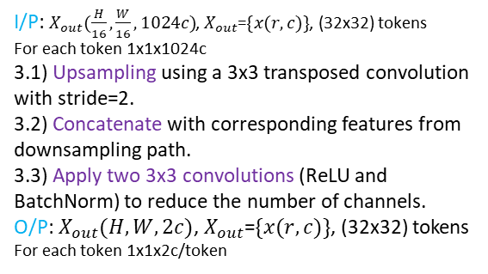
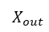
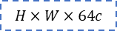
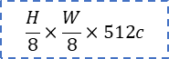
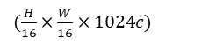
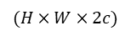
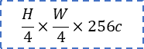
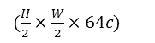
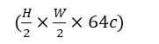
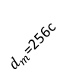
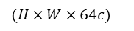
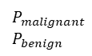

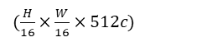
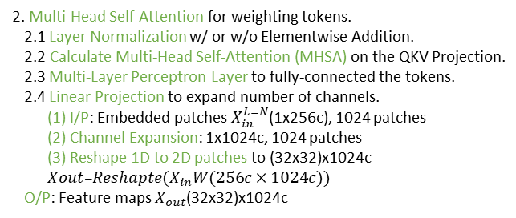
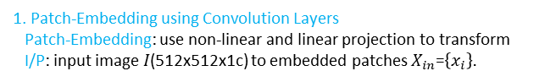
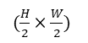
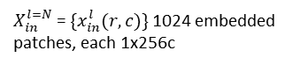
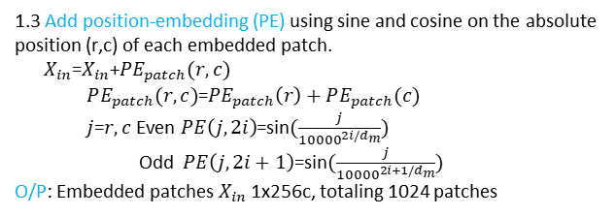
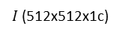
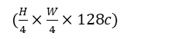
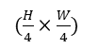
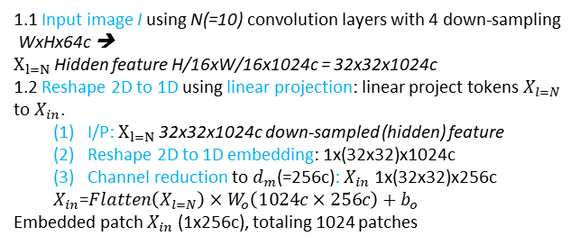
1.1 Introduction: Motivation, Objective and Global Framework
3. Global Framework
4. Global Average Pooling (GAP) and softmax on output tokens.
Input image $I$ (HxWx1c)
3. U-Net Expansive Path for upsampling and feature extraction
I/P: $X_{out}(\frac{H}{16},\frac{W}{16}, 1024c)$, $X_{out}$=$\{x(r,c)\}$, (32x32) tokens
For each token 1x1x1024c
3.1) Upsampling using a 3x3 transposed convolution with stride=2.
3.2) Concatenate with corresponding features from downsampling path.
3.3) Apply two 3x3 convolutions (ReLU and BatchNorm) to reduce the number of channels.
O/P: $X_{out}(H,W, 2c)$, $X_{out}$=$\{x(r,c)\}$, (32x32) tokens For each token 1x1x2c/token
$(H×W×2c)$
$P_{malignant}$
$P_{benign}$
$$H×W×64c$$
$(H×W×64c)$
$I$ (512x512x1c)
$$\frac{H}{2}×\frac{W}{2}×128c$$
$(\frac{H}{2}×\frac{W}{2})$
$1.$Tokenization using Convolution Layers
$$\frac{H}{4}×\frac{W}{4}×256c$$
1.1)
Conv2d
128+128c
BatchNorm
$(\frac{H}{4}×\frac{W}{4})$
$(\frac{H}{2}×\frac{W}{2}×64c)$
$$\frac{H}{8}×\frac{W}{8}×512c$$
$(\frac{H}{2}×\frac{W}{2}×64c)$
ReLu
$$\frac{H}{16}×\frac{W}{16}×1024c$$
$(\frac{H}{8}×\frac{W}{8})$
256+256c
3.2) Concatenate
$(\frac{H}{4}×\frac{W}{4}×128c)$
1.2) Reshape 2D to 1D
3.3) 3x3 Convolutions
1.3) Add positional embedding
Repeat for N(=8) layers
512+512c
2. Multi-Head Self-Attention
$X_{out}$
3.1) Upsampling
$(\frac{H}{8}×\frac{W}{8}×256c)$
$d_{m}$=256c
2.4) Reshape 2D to 1D using linear projection.
$(\frac{H}{16}×\frac{W}{16}×1024c)$
$(\frac{H}{16}×\frac{W}{16}×512c)$
(row, r=0,..,31)
2.1)
2.2)
2.1)
2.3)
$X_{in}^{l=N}$ = $\{x_{in}^{l}(r,c)\}$ 1024 embedded patches, each 1x256c
1.3 Add position-embedding (PE) using sine and cosine on the absolute position (r,c) of each embedded patch.
$X_{in}$=$X_{in}$+$PE_{patch}(r,c)$
$PE_{patch}(r,c)$=$PE_{patch}\left(r\right)+PE_{patch}(c)$
$j$=$r,c$ Even $PE\left(j, 2i\right)$=sin$(\frac{j}{{10000}^{2i/d_{m}}})$
Odd $PE\left(j, 2i+1\right)$=sin$(\frac{j}{{10000}^{2i+1/d_{m}}})$
O/P: Embedded patches $X_{in}$ 1x256c, totaling 1024 patches
(column, c=0,..,31)
Patch-embedding 1x256c, totaling 1024 embedded patches
Annie: Each patch-embedding is vector of size 1x(HxW)x256c. It’s drawn to have 1x1x256c for the ease of discussing (r,c) coordinate on x and y axis.
Patch-Embedding using Convolution Layers
Patch-Embedding: use non-linear and linear projection to transform I/P: input image $I$(512x512x1c) to embedded patches $X_{in}$=$\left\{x_{i}\right\}.$
1.1 Input image I using N(=10) convolution layers with 4 down-sampling
WxHx64c ➔
$X_{l=N}$Hidden feature H/16xW/16x1024c = 32x32x1024c
1.2 Reshape 2D to 1D using linear projection: linear project tokens $X_{l=N}$ to $X_{in}$.
I/P: $X_{l=N}$32x32x1024c down-sampled (hidden) feature
Reshape 2D to 1D embedding: 1x(32x32)x1024c
Channel reduction to $d_{m}$(=256c): $X_{in}$ 1x(32x32)x256c
$X_{in}$=$Flatten\left(X_{l=N}\right)×W_{o}\left(1024c×256c\right)+b_{o}$
Embedded patch $X_{in}$ (1x256c), totaling 1024 patches
2. Multi-Head Self-Attention for weighting tokens.
2.1 Layer Normalization w/ or w/o Elementwise Addition.
2.2 Calculate Multi-Head Self-Attention (MHSA) on the QKV Projection.
2.3 Multi-Layer Perceptron Layer to fully-connected the tokens.
2.4 Linear Projection to expand number of channels.
(1) I/P: Embedded patches $X_{in}^{L=N}$(1x256c), 1024 patches
(2) Channel Expansion: 1x1024c, 1024 patches
(3) Reshape 1D to 2D patches to (32x32)x1024c
$Xout$=$Reshapte(X_{in}W(256c×1024c))$
O/P: Feature maps $X_{out}$(32x32)x1024c
Notes:
J. Chen, Y. Lu, Q. Yu, X. Luo, E. Adeli, Y. Wang, L. Lu, A. L. Yuille, Y. Zhou, “TransUnet: Transformers Make Strong Encoders for Medical Image Segmentation,” in arXiv, 2102.04306, 2021.

Slide 5
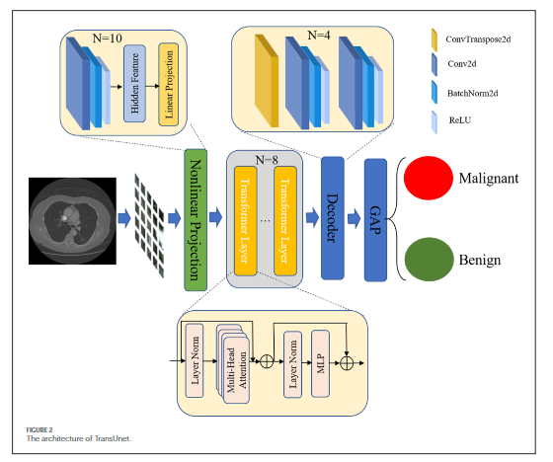
1.1 Introduction: Motivation, Objective and Global Framework
3. Global Framework
Figure 2. The architecture of TransUnet.
TransUnet to identify the nodule level as benign or malignant. TransUnet is based on the transformer and the Unet network. In addition, the structure of TransUnet, as well as the configuration settings, are shown in Figure 2. In particular, the transformer is presented for the purpose of encoding feature representations of input CT scans. Then, the Unet was used to decode the hidden feature for outputting the final classification results.

Slide 6
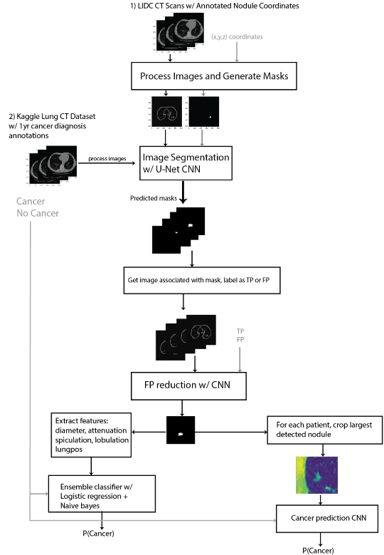
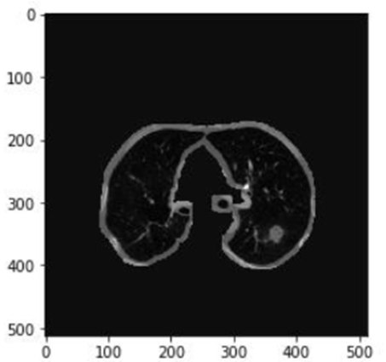
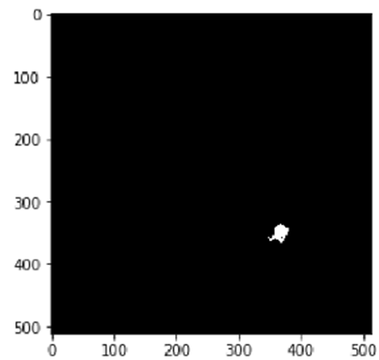
1.2.1 Related Works: Automated Extraction and Classification of Pulmonary Lung Nodules from CT Scans
Determine the features of a nodule that are associated with malignancy.
A CNN model may be used to determine the features associated with cancerous or non-cancerous pulmonary nodules and may reduce the FP rate of CT lung cancer screenings.
Pre-Train on the same U-Net CNN model
(LIDC CT Scans )
Obtain a second large lung CT dataset and isolate the largest nodule from each patient.
Re-Train on the same U-Net CNN model
(Kaggle Lung CT Dataset)
Obtain a second large lung CT dataset and isolate the largest nodule from each patient.
Train a U-Net convolutional neural network for image segmentation of the nodules.
Processed lung image after normalizing and masking off areas that is not the lung tissue.
Nodule mask is generated to be used as a label for nodule segmentation in a U-Net CNN.
False positive reduction. Train a CNN model with labels (TP and FP). Reduce the FP while slightly reducing the TP.
Crop the largest nodule from each patient.
Use CNN to train a classifier (cancerous or non-cancerous).
Figure 2. Obtain a large lung CT dataset that contains annotated nodules that are verified by trained radiologists.

Slide 7




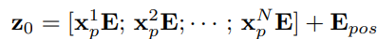
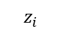
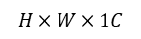

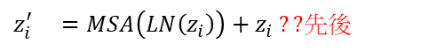
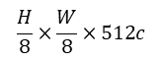
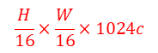
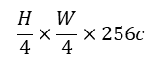











1.2.2 Related Works: TransUNet: Transformers make strong encoders for medical image segmentation
3. Head
Author: CNN-Transformer better than pure transformer
8c: 1bg+7classes
0. Data Augmentation
1.1 Encode - CNN
1.1 Hybrid Model ??
1) ResNet50改良(Reference: ViT[4])
2) BatchNorm改成GroupNorm
3) 傳統的Conv2d改成StdConv2d ?? (以什麼為單位做標準化??)
2. Decode ??
$$H×W×1C$$
HxWx16c
HxWx16c
Flip
HxWx8c
1.1 Why Hybrid Model ??
主要因為BN受batch size大小的影響大(需大量Resource)，BN中權重的更新對於Transfer Learning不友好
Reference: (1912.11370.pdf (arxiv.org))
Rotation
(3x3x16c)x8 filter
8 classes
(8, H, W)
L = $\frac{1}{2}$ $L_{ce}$ + $\frac{1}{2}$ $L_{dice}$
8 heatmaps
CE: discrete
MSE: continue
GT
$$\frac{H}{2}×\frac{W}{2}×64c$$
Tokenize+
Reshape+
Position
$$\frac{H}{4}×\frac{W}{4}×256c$$
Conv3x3→ BN → ReLU
$$\frac{H}{16}×\frac{W}{16}×1024c$$
$$\frac{H}{8}×\frac{W}{8}×512c$$
Conv3x3→ BN→ Softmax
512c+512c
$$\frac{H}{16}×\frac{W}{16}×1024c$$
1D-2D
(8, H, W)
16p x 16p x768c,
N tokens
(D, H/16p, W/16p), p=1
1.2 Encode - Transformer
1) Tokenize - Patch vector (no overlapping)
3) Multi Head Self-Attention (x12)
巧: paper原文 p=16?? 對應回原圖p=16
$z_{i}^{′} =MSA\left(LN\left(z_{i}\right)\right)+z_{i} ??$先後
${x_{p}=\{x}_{p}^{i}$ Є $R^{1×(p^{2}×1024c)} \left| i=1,…N\right\}, N=\frac{HW}{{16}^{2}p^{2}}, p=1$
12 Head
$$p:patch size, N:number of patch$$
$J$ack ??
$$z_{i+1}=MLP\left(LN\left(z_{i}^{′}\right)\right)+z_{i}^{′}$$
$, i=0 \sim 11$
1x(16p x 16p x 1024c), N tokens
$$z_{12}\text{Є} R^{N×D}$$
2) Reshape (Flatten: 2D-1D)
3) Embedding layer by W to fixed size D-dim & position embedding
1x(16p x 16p x 768c) , N tokens
$$z_{i}^{′}$$
$$z_{i+1}$$
$$z_{i}$$
$$z_{0}=$$
D=768
1x(16p x 16p x 768c)
$$(token)$$
$E$ Є $R^{\left(p^{2}×1024c\right)×D filter}, { E}_{pos}$Є $R^{1×D},z_{0}\text{Є} R^{N×D},x_{p}$ $E$ Є $R^{1×D}$
Notes:
Visual Transformer: https://arxiv.org/abs/2010.11929
https://zhuanlan.zhihu.com/p/464920124
https://hackmd.io/@YungHuiHsu/ByDHdxBS5

Slide 8



























1.2.3 Related Works: Attention-Enhanced Cross-Task Network (1/4)
1 Image Volume → 1 to 4 VOIs
1 VOI → 1 nodule
1 nodule in 1 VOI
Global Framework
Pre-Processing on Image Volume
I/P: Image volume $X$: $z×\left(h×w×1c\right)$
$h,w≤512$, $z≤45$ slices and ($h×w×1c$)/slice
1.1 Normalization on Image Volume $X$
Volume of Interest $x_{vk}$ (VOI/nodule) is extracted using bounding box in dataset (k=1 to 4 nodules per volume).
Lateral Padding pads the $x_{v}$ to square, filled with 0s.
Axial Padding pads to the depth to 64 slices, filled with 0s.
Bilinear interpolation $x_{vk}$ ($h×w$) to 64x64.
Mean subtraction and normalization to adjust the mean to zero.
Cropped Volumes of Interest VOI $X$=$[x_{v1},..,x_{vk}]$, $z×(h×w×1c)$
One nodule in one VOI z=64 slices and (64x64x1c)/slice
CT image volume $X$
1.2 Data Augmentation on Each Cropped VOI
Random Flipping on either x or y axis.
Random Rotation to 90, 180, or 270º on x or y axis.
Reverse the slices in z-order.
$X$: $z×(h×w×1c)$,
$h,w≤512$, $z≤45$ slices
O/P: Normalized VOIs $\overline{X}$=$[{\overline{x}}_{v1},..,{\overline{x}}_{vk}]$, $z×(h×w×1c)$
z=64 slices and (64x64x1c)/slice
One VOI (nodule) from $X$ is ${\overline{x}}_{v1}∈x_{v,,i}$
$(h×w×1c)$/slice where i=1st,..,64th slice.
2. CNN Encoder with Slice Attention (SA)
3. Attribute-Specific Content Modulation Module (ASCMM)
2.3 Content-wise Weighted Sum using Slice Attention Module (SAM)
i=1st,..,64th slice.
$z_{1},z_{2},…,z_{n}$ (1x1x1c)/z and n=9
2.1
2.2
Sum across slices
Content Aggregator
Slices ${\hat{x}}_{v,i}$
($8×8×256c$)/slice
Tokens $x_{g,i}$
($1×1×256c$)/token
Feature vector
$f_{v}$=$[f_{v,1},f_{v,2},…,f_{v,n}]$ 9x(1x1x256c)
${\overline{x}}_{v1}∈x_{v,,i}$ $(64×64×1c)$/slice where i=1st,..,64th slice.
Content vector $f_{,c}$
($1×1×256c$)/VOI(nodule)
2. CNN Encoder with Slice Attention Module (SAM)
I/P: Slices $x_{v}$=[$x_{v,i}$]
($64×64×1c$)/slice where i=1st,…,64th slice
2.1 Shared CNN Backbone: Feature Extraction using 2D CNN layers on each slice
Slices ${\hat{x}}_{v,i}$ ($8×8×256c$)/slice where i=1st,…,64th slice
3. Preliminary Attribute Prediction using Attribute-Specific Content Modulation Module (ASCMM)
I/P: Content Vector $f_{c}$ (1x1x256c)/VOI(nodule)
$y_{1},y_{2},…,y_{n}$ (1x1x1c)/y
Slices ${\hat{x}}_{v,i}$
($h×w×256c$)/slice
Tokens $x_{g,i}$
($1×1×256c$)/token
3.1 Specialize k(=9) pathways for individual attribute in each batch B(=1)
$f_{v,n}$=$W_{0(256×256)}f_{c}+b_{0}$
$w_{n}$=$W_{1(256x1)}f_{v,n}$
2.2 Global Average Pooling for Tokenization, flattening (2D to 1D) each slice.
$GAP({\hat{x}}_{v,i})$=$\frac{1}{h×w}\sum_{n=1}^{h=8}{\sum_{m=1}^{w=8}{x_{v,c}(n,m)}}$ for channel c=1,..,256
Tokens $x_{g,i}$ ($1×1×256c$)/token where i=1st,…,64th token(=flattened slice)
Content vector $f_{,c}$
($1×1×256c$)
Feature vector $f_{v}$ 9x(1x1x256c)
2.3 Content-wise Weighted Sum using Slice Attention Module (SAM) on tokens $x_{g,i}$.
1) A scalar attention weight $α_{i}$ (1x1x1c) on each token using Softmax
$α{\left(p\right)}_{i}$=$\frac{e^{p_{i}}}{\sum_{j}{e^{p_{j}}}}$ where $p_{j}$=$W_{1\left(128×1\right)}{\left(W_{0\left(128×256\right)}x_{g,i}+b_{0}\right)}_{RELU}+b_{1}$
2) Sum the attention-weighted tokens $x_{g,i}$ across slices
$f_{c}$=$\sum_{i}{(α_{i}x_{g,i})}$
3.2 Find the probability $y_{n}∈(0,1)$ for each attribute.
$y_{n}$=$σ(w_{n})$=$\frac{1}{1+e^{−w_{n}}}$ Sigmoid for each attribute n
O/P: Preliminary attribute prediction $y_{1},y_{2},…,y_{n}$ (1x1x1c) and n=k(=9)
Feature vector $f_{v}$=$[f_{v,1},f_{v,2},…,f_{v,n}]$ 9x(1x1x256c)
O/P: Nodule Content Vector $f_{c}$ (1x1x256c)/VOI(nodule)
Notes:
1st transform performs affine transformation that keeps the lines in parallel and needs a bias term to be the constant shift. Ensure that there are features even when the input is zero.
2nd transform only performs scaling

Slide 9

















1.2.3 Related Works: Attention-Enhanced Cross-Task Network (2/4)
1 Image Volume → 1 to 4 VOIs
1 VOI → 1 nodule
1 nodule in 1 VOI
Global Framework
2. CNN Encoder with Slice Attention (SA)
3. Attribute-Specific Content Modulation Module (ASCMM)
2.3 Content-wise Weighted Sum using Slice Attention Module (SAM)
i=1st,..,64th slice.
$z_{1},z_{2},…,z_{n}$ (1x1x1c)/z and n=9
2.1
2.2
Sum across slices
Content Aggregator
Slices ${\hat{x}}_{v,i}$
($8×8×256c$)/slice
Tokens $x_{g,i}$
($1×1×256c$)/token
$f_{v}$=$[f_{v,1},f_{v,2},…,f_{v,n}]$ 9x(1x1x256c)
${\overline{x}}_{v1}∈x_{v,,i}$ $(64×64×1c)$/slice where i=1st,..,64th slice.
Content vector $f_{,c}$
($1×1×256c$)/VOI(nodule)
4. Cross-Attribute Attention Module (CAAM)
4. Weight Attribute Using Cross-Attribute Attention Module (CAMM)
I/P: $f_{v}$=$[f_{v,1},…,f_{v,n}]$ where n=9
5. Final Attribute Prediction
Attribute weight $w_{n}$(1x1x1c)
Attribute vector
$f_{a,1},..,f_{a,n}$
$f_{a,n}$ (1x1x256c)
Specialize k(=9) pathways for individual attribute in each batch B(=1)
$f_{a,n}$=$\sum_{b=1}^{B}{w_{n}}∙f_{v,n}$ attribute vector
$w_{n}$=$W_{1\left(128x1\right)}{\left(W_{0\left(256×128\right)}f_{v,n}+b_{0}\right)}_{RELU}+b_{1}$ (1x1x1c) for n=1,…,k
Feature vector $f_{v,n}$(1x1x256c)
Attribute vector $f_{a,n}$(1x1x1c)
O/P: Attribute weight $w_{n}$=$[w_{1},…,w_{n}]$ where n=1,…,k 9x(1x1x1c)
Attribute vector $f_{a}$=$[f_{a,n },…, f_{a,n}]$ 9x(1x1x256c)
5. Final Attribute Prediction
I/P: Attribute vector $f_{a}$=$[f_{a,1},…,f_{a,n}]$ where n=9
n=k(=9) for k different attributes
Output Predictions
$z_{1},z_{2},…,z_{n}$ (1x1x1c)
Attribute vector $f_{a,n}$ (1x1x256c)
Output prediction
$z_{n}$ (1x1x256c)
Specialize k(=9) pathways for individual attribute in each batch B(=1)
$w_{n}$=$W_{1\left(256×1\right)}{\left(W_{0\left(256×256\right)}f_{a,n}+b_{0}\right)}_{RELU}$ (1×1×1c)
$z_{n}$=$σ\left(y_{n}\right)=\frac{1}{1+e^{−y_{n}}}$ Sigmoid for each attribute n
O/P: Final attribute prediction $z_{1},z_{2},…,z_{n}$ (1x1x1c) and n=9

Slide 10


















1.2.3 Related Works: Attention-Enhanced Cross-Task Network (3/4)
Shared CNN Backbone
CT image volume $X$
Pre-Processing on Image Volume
I/P: Image volume $X$: $z×\left(h×w×1c\right)$
$h,w≤512$, $z≤45$ slices and ($h×w×1c$)/slice
1.1 Normalization on Image Volume $X$
Cropped Volumes of Interest VOI $X$=$[x_{v1},..,x_{vk}]$, $z×(h×w×1c)$
One nodule in one VOI z=64 slices and (64x64x1c)/slice
1.2 Data Augmentation on Each Cropped VOI
O/P: Normalized VOIs $\overline{X}$=$[{\overline{x}}_{v1},..,{\overline{x}}_{vk}]$, $z×(h×w×1c)$
z=64 slices and (64x64x1c)/slice
$X$: $z×(h×w×1c)$,
$h,w≤512$, $z≤45$ slices
3. Attribute-Specific Content Modulation Module (ASCMM)
2. CNN Encoder with Slice Attention (SA)
2.3 Content-wise Weighted Sum using Slice Attention Module (SAM)
4. Cross-Attribute Attention Module (CAAM)
i=1st,..,64th slice.
5. Final Attribute Prediction
2.1
2.2
Sum across slices
Content Aggregator
Slices ${\hat{x}}_{v,i}$
($8×8×256c$)/slice
Tokens $x_{g,i}$
($1×1×256c$)/token
Feature vector
$f_{v}$=$[f_{v,1},f_{v,2},…,f_{v,n}]$ 9x(1x1x256c)
${\overline{x}}_{v1}∈x_{v,,i}$ $(64×64×1c)$/slice where i=1st,..,64th slice.
Content vector $f_{,c}$
($1×1×256c$)/VOI(nodule)
Output Predictions
$z_{1},z_{2},…,z_{n}$ (1x1x1c)
2. CNN Encoder with Slice Attention Module (SAM)
I/P: Slices $x_{v}$=[$x_{v,i}$]
($64×64×1c$)/slice where i=1st,…,64th slice
2.1 Shared CNN Backbone: Feature Extraction using 2D CNN layers on each slice
Slices ${\hat{x}}_{v,i}$ ($8×8×256c$)/slice where i=1st,…,64th slice
2.2 Global Average Pooling for Tokenization, flattening (2D to 1D) each slice.
$GAP({\hat{x}}_{v,i})$=$\frac{1}{h×w}\sum_{n=1}^{h}{\sum_{m=1}^{w}{x_{v,c}(n,m)}}$ for channel c=1,..,256
Tokens $x_{g,i}$ ($1×1×256c$)/token where i=1st,…,64th token(=flattened slice)
2.3 Content-wise Weighted Sum using Slice Attention Module (SAM) on tokens $x_{g,i}$.
1) A scalar attention weight $α_{i}$ (1x1x1c) on each token using Softmax
$α{\left(p\right)}_{i}$=$\frac{e^{p_{i}}}{\sum_{j}{e^{p_{j}}}}$ where $p_{j}$=$W_{1\left(128×1\right)}{\left(W_{0\left(128×256\right)}x_{g,i}+b_{0}\right)}_{RELU}+b_{1}$
2) Sum the attention-weighted tokens $x_{g,i}$ across slices
$f_{c}$=$\sum_{i}{(α_{i}x_{g,i})}$
Slices ${\hat{x}}_{v,i}$
($8×8×256c$)/slice
Tokens $x_{g,i}$
($1×1×256c$)/token
O/P: Nodule Content Vector $f_{c}$ (1x1x256c)/VOI(nodule)
($64×64×1c$)/slice
($32×32×32c$)/slice
($16×16×64c$)/slice
($8×8×128c$)/slice
($8×8×256c$)/slice

Slide 11




















1.2.3 Related Works: Attention-Enhanced Cross-Task Network (4/4)
Attribute Content and Cross-Attribute Attention
CT image volume $X$
3. Preliminary Attribute Prediction using Attribute-Specific Content Modulation Module (ASCMM)
I/P: Content Vector $f_{c}$ (1x1x256c)/VOI(nodule)
3.2 Find the probability $y_{n}∈(0,1)$ for each attribute.
$y_{n}^{ASCMM}$=$σ(w_{n})$=$\frac{1}{1+e^{−w_{n}}}$ Sigmoid for each attribute n
O/P: Preliminary attribute prediction $y_{1},y_{2},…,y_{n}$ (1x1x1c) and n=k(=9)
Feature vector $f_{v}$=$[f_{v,1},f_{v,2},…,f_{v,n}]$ 9x(1x1x256c)
$y_{1},y_{2},…,y_{n}$ (1x1x1c)/y
3.1 Specialize k(=9) pathways for individual attribute in each batch B(=1)
$f_{v,n}$=$W_{0(256×256)}f_{c}+b_{0}$
$w_{n}$=$W_{1(256x1)}f_{v,n}$
$X$: $z×(h×w×1c)$,
$h,w≤512$, $z≤45$ slices
Content vector $f_{,c}$
($1×1×256c$)
Feature vector $f_{v}$ 9x(1x1x256c)
Loss Function (Mean Squared Error):
$L$=$\frac{1}{N}\sum_{i}{||{\hat{y}}_{n}−y_{n}^{ASCMM}||}$
Pre-Processing on Image Volume
$N$ number of nodule in 1 batch (=1 nodule)
2. CNN Encoder with Slice Attention (SA)
3. Attribute-Specific Content Modulation Module (ASCMM)
2.3 Content-wise Weighted Sum using Slice Attention Module (SAM)
4. Cross-Attribute Attention Module (CAAM)
i=1st,..,64th slice.
5. Attribute Prediction
2.1
Content Aggregator
2.2
Sum across slices
Slices ${\hat{x}}_{v,i}$
($8×8×256c$)/slice
Tokens $x_{g,i}$
($1×1×256c$)/token
${\overline{x}}_{v1}∈x_{v,,i}$ $(64×64×1c)$/slice where i=1st,..,64th slice.
Content vector $f_{,c}$
($1×1×256c$)/VOI(nodule)
Output Predictions
$z_{1},z_{2},…,z_{n}$ (1x1x1c)
4. Weight Attribute Using Cross-Attribute Attention Module (CAMM)
I/P: $f_{v}$=$[f_{v,1},…,f_{v,n}]$ where n=9
5. Final Attribute Prediction
I/P: Attribute vector $f_{a}$=$[f_{a,1},…,f_{a,n}]$ where n=9
Attribute weight $w_{n}$(1x1x1c)
Specialize k(=9) pathways for individual attribute in each batch B(=1)
$f_{a,n}$=$\sum_{b=1}^{B}{w_{n}}∙f_{v,n}$ attribute vector
$w_{n}$=$W_{1\left(128x1\right)}{\left(W_{0\left(256×128\right)}f_{v,n}+b_{0}\right)}_{RELU}+b_{1}$ (1x1x1c) for n=1,…,k
Attribute vector $f_{a,n}$ (1x1x256c)
Output prediction
$z_{n}$ (1x1x256c)
Feature vector $f_{v,n}$(1x1x256c)
Attribute vector $f_{a,n}$(1x1x1c)
Specialize k(=9) pathways for individual attribute in each batch B(=1)
$w_{n}$=$W_{1\left(256×1\right)}{\left(W_{0\left(256×256\right)}f_{a,n}+b_{0}\right)}_{RELU}$ (1×1×1c)
$y_{n}^{final}$=$σ\left(w_{n}\right)=\frac{1}{1+e^{−w_{n}}}$ Sigmoid for each attribute n
O/P: Attribute weight $w_{n}$=$[w_{1},…,w_{n}]$ where n=1,…,k 9x(1x1x1c)
Attribute vector $f_{a}$=$[f_{a,n },…, f_{a,n}]$ 9x(1x1x256c)
O/P: Final attribute prediction $z_{1},z_{2},…,z_{n}$ (1x1x1c) and n=9
Loss Function (Mean Squared Error):
$L$=$\frac{1}{N}\sum_{i}{||{\hat{y}}_{n}−y_{n}^{final}||}$
$N$ number of nodule in 1 batch (=1 nodule)

Slide 12




1.2.3 Related Works: An image is worth 16x16 words: Transformers for image recognition at scale
ViT[4] An image is worth 16x16 words: Transformers for image recognition at scale.
Hybrid Model ??
1) ResNet50改良
2) BatchNorm改成GroupNorm (32c)
3) 傳統的Conv2d改成StdConv2d
對模型weight ($shape=(filter×H×W×C)$)的每一個layer (也就是包含H、W、C) 做標準化，$w^{′}=\frac{w−μ}{σ}$)
Reference Paper (1912.11370.pdf (arxiv.org))
使用Group Normalization (GN)、Weight Standardization (WS) 替換Batch Normalization (BN) 。主要因為 (1) BN受batch size大小的影響較大(需要大量的Resource)，(2) BN中權重的更新對於Transfer Learning (Based on PreTrain ViT[4])不友好。實驗證明，GN、WS的設計對於遷移學習有很大的影響。
Hybrid Model
ResNet50
Block:
StdConv1x1→GN→ReLU
StdConv3x3→GN→ReLU
StdConv1x1→ReLU

Slide 13





1.2.4 Related Works: BiTr-Unet: a CNN-Transformer combined network for MRI brain tumor segmentation
transformer block
BiTr-Unet (Brain Tumor)
Input four 3D MRI modalities images (128x128x128x4c)
Get more information on low resolution (global feature) feature using transformer block
Attention Gate (Pixel-wise)
U-Net Transformer
MHSA : multi head self attention (MSA)
MHCA : multi head cross attention (similar as “attention gate”)
Gate
Low resolution
X
High resolution
MHCA
X
High resolution
Gate
Low resolution
Reference:
BiTr-Unet: MICCAI2021, cite 32
U-Net Transformer: MLMI2021, cite 101

Slide 14



1.2.4 Related Works: BiTr-Unet: a CNN-Transformer combined network for MRI brain tumor segmentation
Swin-UNETR
Input four 3D MRI modalities images (128x128x128x4c)
Feature extraction by Swin Transformer and downsampling by patch merging
Trained on a DGX-1 cluster with NVIDIA V100 GPUs x 8 (batch size = 8)
Swin-Unet ??
Input four 3D MRI modalities images (224x224x1c)
Feature extraction by Swin Transformer and downsampling by patch merging
Trained on a DGX-1 cluster with NVIDIA V100 GPUs x1
Patch Expanding (upsmapling)??
Patch expanding layer 以解码器中第一个为例，在上采样之前，在输入特征(W/32×H/32×8C)上應用線性層，将特征维度增加到2×原始尺寸(W/32×H/32×16C)。然后，利用rearrange操作，将输入特征的分辨率擴展到2倍的输入分辨率，并将特征维度降小到输入维度的四分之一(W/32×H/32×16C→W/16×H/16×4C)。（Patch merging的逆操作）
Reference:
Swin-UNETR: MICCAI2022, cite 123
Swin-Unet: ECCV2021, cite 676
Notes:
random axis mirror flip with a probability of 0.5 for all 3 axes

Slide 15

1.2.5 Related Works: TransFuse: Fusing Transformers and CNNs for Medical Image Segmentation
TransFuse
Input four 3D MRI modalities images (128x128x128x4c)
Combine transformer and CNN feature using BiFusion module
Trained on NVIDIA A100 GPU x 1
Transf t
Channel Attention ??
Spatial Attention ??
CNN g
Reference:
Swin-UNETR: MICCAI2021, cite 340

Slide 16


1.2.6 Related Works: UTNet: A Hybrid Transformer Architecture for Medical Image Segmentation
UTNet
Input MRI 2D images (256x256x1c)
Combine transformer and CNN feature
Add transformer and CNN layer
Position embedding ??
Q(K+R) ??
Subpixel sample = upsample
Position embedding ??
Reference:
UTNet: MICCAI 2021, cite 174

Slide 17


1.2.7 Related Works: DS-TransUNet: Dual Swin Transformer U-Net for Medical Image Segmentation
DsTransUNet
Input 2D images (256x256x1c)
Dual Swin Transformer mechanism
Trained on NVIDIA RTX3090 GPU
The proposed TIF module is developed to establish global dependencies between features of different scales through the self-attention mechanism
GAP: Global Average Pooling
Upsampling
GAP
GAP
Reference:
DsTransUNet: TIM 2022, cite 130

Slide 18
1.3 Contribution
The use of transformers allows for the extraction of global and discriminative features from CT images, improving the model’s ability to differentiate between benign and malignant nodules.
Model TransUnet has significant potential for real-world application in lung cancer diagnosis, aiding clinicians in making informed decisions.

Slide 19
2.1 System Setup

Slide 20
2.2 System Specification

Slide 21


























3.1.1 Training Framework: Tokenization (1/2)
4. Global Average Pooling (GAP) and softmax on output tokens.
Input image $I$ (HxWx1c)
3. U-Net Expansive Path for upsampling and feature extraction
I/P: $X_{out}(\frac{H}{16},\frac{W}{16}, 1024c)$, $X_{out}$=$\{x(r,c)\}$, (32x32) tokens
For each token 1x1x1024c
3.1) Upsampling by using a 3x3 transposed convolution with stride=2.
3.2) Concatenate with corresponding features from downsampling path.
3.3) Apply two 3x3 convolutions (ReLU and BatchNorm) to reduce the number of channels.
O/P: $X_{out}(H,W, 2c)$, $X_{out}$=$\{x(r,c)\}$, (32x32) tokens For each token 1x1x2c/token
$(H×W×2c)$
$P_{malignant}$
$P_{benign}$
$$H×W×64c$$
Layer 2
$(H×W×64c)$
$I$ (512x512x1c)
$$\frac{H}{2}×\frac{W}{2}×128c$$
$(\frac{H}{2}×\frac{W}{2})$
$1.$Tokenization using convolution layers
Layer 4
1.1) Tokenize Input
$$\frac{H}{4}×\frac{W}{4}×256c$$
Conv2d
Layer 6
128+128c
BatchNorm
$$\frac{H}{8}×\frac{W}{8}×512c$$
$(\frac{H}{4}×\frac{W}{4})$
$(\frac{H}{2}×\frac{W}{2}×64c)$
$(\frac{H}{2}×\frac{W}{2}×64c)$
ReLu
Layer 8
$P$=$\{p(r,c)\}$ 32x32 patches,
each 1x1x1024c
$$\frac{H}{16}×\frac{W}{16}×1024c$$
256+256c
1.2) Reshape 2D to 1D
Layer 10
3.2) Concatenate
$(\frac{H}{8}×\frac{W}{8})$
$(\frac{H}{4}×\frac{W}{4}×128c)$
1.3) Add positional embedding
512+512c
3.3)) 3x3 Convolutions
2. Multi-Head Self-Attention
$X_{out}$
3.1) Upsampling
$(\frac{H}{8}×\frac{W}{8}×256c)$
$d_{m}$=256c
Repeat for N(=8) layers
2.4) Linear Projection to 1024c
$(\frac{H}{16}×\frac{W}{16}×1024c)$
$(\frac{H}{16}×\frac{W}{16}×512c)$
(row, r=0,..,31)
2.1)
2.2)
2.1)
2.3)
(column, c=0,..,31)
$X_{in}^{l=N}$ = $\{x_{in}^{l}(r,c)\}$ 1024 embedded patches, each 1x256c
Patch-embedding 1x256c, totaling 1024 embedded patches
Patch-embedding using convolution layers
Embedding patches: use non-linear and linear projection to transform input $I$(512x512x1c) to tokens $X_{in}$=$\left\{x_{i}\right\}.$
1.1) Input Image I using N(=10) convolution layers for downsampling.
$X_{l}$=$ReLU(BatchNrom\left(Conv\left(X_{l}, W_{l}\right)+b_{l}\right))$ layer $l$=1,..,N
$H×W×64c$
$\frac{H}{2}×\frac{W}{2}×128c$
$\frac{H}{2}×\frac{W}{2}×128c$
$\frac{H}{16}×\frac{W}{16}×1024c$
$X_{l=N} (\frac{H}{16}×\frac{W}{16}×1024c)$
$H×W×64c$
$\frac{H}{4}×\frac{W}{4}×256c$
$\frac{H}{4}×\frac{W}{4}×256c$
$\frac{H}{8}×\frac{W}{8}×512c$
$\frac{H}{8}×\frac{W}{8}×512c$
I($H×W$ $×$1c)
$\frac{H}{16}×\frac{W}{16}×1024c$
Conv(3x3, s=1, 1024c)
Conv(3x3, s=2, 1024c)
Conv(3x3, s=1, 512c)
Conv(3x3, s=1, 64c)
Conv(3x3, s=2, 512c)
Conv(3x3, s=1, 64c)
Conv(3x3, s=2, 128c)
Conv(3x3, s=1, 128c)
Conv(3x3, s=1, 256c)
Conv(3x3, s=2, 256c)
Proceed to step 1.2) and 1.3)
I/P: $I$ (512×512×1c)
$H×W×1c$
O/P: Embedded patch $X_{in}$ (1x256c), totaling 1024 patches
Layer 1
Layer 2
Layer 3
Layer 4
Layer 5
Layer 6
Layer 7
Layer 8
Layer 9
Layer N(=10)
Notes:
J. Chen, Y. Lu, Q. Yu, X. Luo, E. Adeli, Y. Wang, L. Lu, A. L. Yuille, Y. Zhou, “TransUnet: Transformers Make Strong Encoders for Medical Image Segmentation,” in arXiv, 2102.04306, 2021.

Slide 22



















3.1.1 Training Framework: U-Net Expansive Path (2/2)
Input image $I$ (HxWx1c)
4. Global Average Pooling (GAP) and softmax on output tokens.
3. U-Net Expansive Path for upsampling and feature extraction
I/P: $X_{out}(\frac{H}{16},\frac{W}{16}, 1024c)$, $X_{out}$=$\{x(r,c)\}$, (32x32) tokens
For each token 1x1x1024c
3.1) Upsampling by using a 3x3 transposed convolution with stride=2.
3.2) Concatenate with corresponding features from downsampling path.
3.3) Apply two 3x3 convolutions (ReLU and BatchNorm) to reduce the number of channels.
O/P: $X_{out}(H,W, 2c)$, $X_{out}$=$\{x(r,c)\}$, (32x32) tokens For each token 1x1x2c/token
$(H×W×2c)$
$P_{malignant}$
$P_{benign}$
$$H×W×64c$$
Layer 2
$(H×W×64c)$
$I$ (512x512x1c)
$$\frac{H}{2}×\frac{W}{2}×128c$$
$(\frac{H}{2}×\frac{W}{2})$
$1.$Tokenization using convolution layers
Layer 4
1.1) Tokenize Input
$$\frac{H}{4}×\frac{W}{4}×256c$$
Conv2d
Layer 6
128+128c
BatchNorm
$$\frac{H}{8}×\frac{W}{8}×512c$$
$(\frac{H}{4}×\frac{W}{4})$
$(\frac{H}{2}×\frac{W}{2}×64c)$
$(\frac{H}{2}×\frac{W}{2}×64c)$
ReLu
Layer 8
$P$=$\{p(r,c)\}$ 32x32 patches,
each 1x1x1024c
$$\frac{H}{16}×\frac{W}{16}×1024c$$
256+256c
1.2) Reshape 2D to 1D
Layer 10
3.2) Concatenate
$(\frac{H}{8}×\frac{W}{8})$
$(\frac{H}{4}×\frac{W}{4}×128c)$
1.3) Add positional embedding
512+512c
3.3) 3x3 Convolutions
2. Multi-Head Self-Attention
$X_{out}$
3.1) Upsampling
$(\frac{H}{8}×\frac{W}{8}×256c)$
(row, r=0,..,31)
$d_{m}$=256c
Repeat for N(=8) layers
2.4) Linear Projection to 1024c
$(\frac{H}{16}×\frac{W}{16}×1024c)$
$(\frac{H}{16}×\frac{W}{16}×512c)$
(column, c=0,..,31)
2.2)
2.1)
2.3)
$X_{in}^{l=N}$ = $\{x_{in}^{l}(r,c)\}$ 1024 embedded patches, each 1x256c
2.1)
Patch-embedding 1x256c, totaling 1024 embedded patches
3. U-Net Expansive Path for upsampling and feature extraction
I/P: Embedded patch $X_{in}$ (1x256c), totaling 1024 patches
4. Global Average Pooling (GAP) and softmax on output tokens.
$\frac{H}{8}×\frac{W}{8}×512c$
$\frac{H}{8}×\frac{W}{8}×1024c$
$\frac{H}{8}×\frac{W}{8}×256c$
$\frac{H}{4}×\frac{W}{4}×256c$
$\frac{H}{4}×\frac{W}{4}×512c$
$\frac{H}{4}×\frac{W}{4}×128c$
$\frac{H}{2}×\frac{W}{2}×128c$
$\frac{H}{2}×\frac{W}{2}×256c$
$\frac{H}{2}×\frac{W}{2}×64c$
$H×W×64c$
GAP and softmax
Convd(3x3, s=1, 2c)
Convd(3x3, s=1, 32c)
Convd(3x3, s=2, 128c)
Convd(3x3, s=2, 64c)
Convd(3x3, s=1, 128c)
Concate(Layer 4, 256c)
Concate(Layer 6, 512c)
Convd(3x3, s=1, 64c)
Convd(3x3, s=2, 512c)
Convd(3x3, s=2, 256c)
Convd(3x3, s=1, 256c)
Convd(3x3, s=1, 128c)
Convd(3x3, s=1, 256c)
Convd(3x3, s=1, 512c)
Concate(Layer 8, 1024c)
Restored feature maps $X_{out}$
$(\frac{H}{16}×\frac{W}{16}×1024c)$
O/P:${[P}_{malignant}$ ,$P_{benign}$]
$1×2c$
$\frac{H}{16}×\frac{W}{16}×1024c$
3.1)
3.2)
3.3)
3.1)
3.2)
3.3)
3.1)
3.2)
3.3)
3.1)
3.3)

Slide 23








3.1.2 Inference Framework
4. Global Average Pooling (GAP) and softmax on output tokens.
Input image $I$ (HxWx1c)
3. U-Net Expansive Path for upsampling and feature extraction
I/P: $X_{out}(\frac{H}{16},\frac{W}{16}, 1024c)$, $X_{out}$=$\{x(r,c)\}$, (32x32) tokens
For each token 1x1x1024c
3.1) Upsampling by using a 3x3 transposed convolution with stride=2.
3.2) Concatenate with corresponding features from downsampling path.
3.3) Apply two 3x3 convolutions (ReLU and BatchNorm) to reduce the number of channels.
O/P: $X_{out}(H,W, 2c)$, $X_{out}$=$\{x(r,c)\}$, (32x32) tokens For each token 1x1x2c/token
$(H×W×2c)$
$P_{malignant}$
$P_{benign}$
$$H×W×64c$$
Layer 2
$(H×W×64c)$
$$\frac{H}{2}×\frac{W}{2}×128c$$
$(\frac{H}{2}×\frac{W}{2})$
O/P:${[P}_{malignant}$ ,$P_{benign}$]
$1×2c$
$I$ (512x512x1c)
Layer 4
$1.$Tokenization using convolution layers
$$\frac{H}{4}×\frac{W}{4}×256c$$
1.1) Tokenize Input
Conv2d
Layer 6
128+128c
BatchNorm
$$\frac{H}{8}×\frac{W}{8}×512c$$
$(\frac{H}{4}×\frac{W}{4})$
$(\frac{H}{2}×\frac{W}{2}×64c)$
$(\frac{H}{2}×\frac{W}{2}×64c)$
ReLu
Layer 8
$P$=$\{p(r,c)\}$ 32x32 patches,
each 1x1x1024c
$$\frac{H}{16}×\frac{W}{16}×1024c$$
256+256c
1.2) Reshape 2D to 1D
Layer 10
3.2) Concatenate
$(\frac{H}{8}×\frac{W}{8})$
$(\frac{H}{4}×\frac{W}{4}×128c)$
1.3) Add positional embedding
512+512c
3.3) 3x3 Convolutions
2. Multi-Head Self-Attention
$X_{out}$
3.1) Upsampling
$(\frac{H}{8}×\frac{W}{8}×256c)$
(row, r=0,..,31)
$d_{m}$=256c
Repeat for N(=8) layers
2.4) Linear Projection to 1024c
$(\frac{H}{16}×\frac{W}{16}×1024c)$
$(\frac{H}{16}×\frac{W}{16}×512c)$
(column, c=0,..,31)
2.2)
2.1)
2.3)
$X_{in}^{l=N}$ = $\{x_{in}^{l}(r,c)\}$ 1024 embedded patches, each 1x256c
2.1)
Patch-embedding 1x256c, totaling 1024 embedded patches
Patch-embedding using convolution layers
Patch-embedding: use non-linear and linear projection to transform input $I$(512x512x1c) to tokens $X_{in}$=$\left\{x_{i}\right\}.$
2. Multi-Head Self-Attention for weighting tokens.
I/P: Tokens $X_{in}$=$\{x_{l}\left(r,c\right)|r,c=0,..,31\}$
For each token (1×1×256c). Totaling (32x32) tokens
I/P: $I$ (512×512×1c)
2.1) Layer Normalization w/ or w/o Elementwise Addition.
1.1) Input Image I using N(=10) convolution layers for downsampling.
2.3) Multi-Layer Perceptron Layer to fully-connected the tokens.
1.2) Reshape 2D to 1D using Linear Projection: linear project tokens $X_{l=N}$ to $X_{in}$.
2.4) Linear Projection to expand number of channels.
O/P: $X_{in}^{l=N}=\left\{x_{in}^{l=N}\left(r,c\right)\right\}\text{(32}\text{x}\text{32) }\text{tokens}$
$\text{For} \text{each} \text{token}\text{ (1}\text{×}\text{1}\text{×}\text{1024}\text{c}\text{)}$
1.3) Add positional embedding using sine and cosine.
O/P: Embedded patches $X_{in}$ 1x256c, totaling 1024 patches

Slide 24

3.1.3 Loss Function
Loss $L_{ce}$ (cross entropy loss)
$\text{Loss} \text{Function}$ $ℒ\text{ (}\text{Cross}\text{−}\text{Entropy} \text{Loss}\text{):}$
$ℒ\left(Pr,Y_{true}\right)$=$−\frac{1}{B}\sum_{b=1}^{B}{\sum_{n=0}^{n_cls}{Y_{true, bn}log⁡(Pr(b,i))}}$
- $Y_{true, bn} : \text{True} \text{label} \text{for} \text{the} b^{th}$ batch and $n^{th}$ classes
$Pr⁡(b,i)$ $:$Predicted probs for the $b^{th}$batch and $i^{th}$ image/sample
- $B$ : Batch size
- $n_{cls}: \text{Number} \text{o}\text{f} \text{classes}$(=2)

Slide 25

















3.2 Multi-Head Self-Attention (MHSA)
$X^{l=N}$ = $\{x^{l}(r,c)\}$ 32x32 tokens each 1x1x256c
2. Multi-Head Self-Attention
2.4)
H=32 tokens
H=32 tokens
$d_{m}$=256c
$X^{l=N}$
Conv(3x3, s=1, 1024c)
$d_{m}$=256c
W=32 tokens
2.1)
2.2)
2.1)
2.3)
W=32 tokens
$X_{in}^{l−1}$=$\{x_{in}(r,c)\}$ 32x32 tokens, each 1x1x256c
Repeat for N(=8) layers, starting with $l=1$ layer
$X_{out}$ = $\{x_{out}(r,c)\}$ 32x32 tokens each 1x1x1024c
2. Multi-Head Self-Attention for weighting tokens.
2.1) Layer Normalization (LN) wo/ or w/ Residual Addition: on the Input data $X$ and attention output ${\hat{X}}_{}^{ℓ}$of Transformer block $ℓ$.
I/P Tokens $X_{in}^{l−1}$=$\{x_{in}^{l−1}(r,c)\}$, 32×32 tokens, 1×1× $d_{m}(=256c)$/token, $ℓ$=1
${\hat{X}}^{ℓ}$=$MHSA({LN(X}^{ℓ−1}))+X^{ℓ−1}$
Residual (element-wise) addition on input patches to layer $ℓ$
${\hat{X}}^{ℓ−1 }$ wo/ normalized input
O/P Normalized Tokens ${{\hat{X}}_{in}}^{ℓ−1}$=$\{{\hat{x}}_{in}^{l−1}(r,c)\}$, 1×1× $d_{m}$(=256c) each, $r,c=0,…,i$, where i=31 for 32×32 tokens
2.2) Calculate Multi-Head Self-Attention (MHSA): for each of h(=8) heads, on the query Q, key K and value V matrix projected from the normalized input ${{\hat{X}}_{in}}^{ℓ−1 }$.
I/P Normalized Tokens ${\hat{X}}^{ℓ−1}$=$\{{\hat{x}}_{in}^{l−1}(r,c)\}$
Generate Q, K, V
Calculate Multi-Head Self-Attention
$Q_{N×d}$=${\hat{X}}^{ℓ−1 }(N×d_{m})W_{Q}(d_{m}$×$d$)
$K_{N×d_{k}}$= ${\hat{X}}^{ℓ−1 }(N×d_{m}) W_{K}(d_{m}$×$d$)
$V_{N×d_{v}}$= ${\hat{X}}^{ℓ−1 }(N×d_{m}) W_{V}(d_{m}$×$d$)
$W_{i}^{Q}$($d$× $d$)
$W_{i}^{K}$($d$× $d_{k}$)
$W_{i}^{V}$($d$× $d_{V}$)
${\hat{X}}^{ℓ}$=MultiHead$(Q,K,V)$=Concat($A_{i=1},..,A_{i=h}$)$W_{d_{v}×d_{m}}^{O}$
where $A_{i}$=Attention$(QW_{i}^{Q}, KW_{i}^{Q}, VW_{i}^{Q}$)
Attention$(Q, K, V)$=$softmax\left(\frac{QK^{T}}{\sqrt{d_{k}}}\right)V$
$QK^{T}$= $N^{2}$×$N^{2}$ for token 0 to i in row r or column c
h=8 heads
$d$=$d_{m}$(=256c)
$d_{k}$=$d_{v}$=$d_{m}/h$ (=32c)
${\hat{X}}^{ℓ}$=$\left[{{\hat{x}}_{cls}}^{ℓ}{,{ \hat{x}}_{1}}^{ℓ},{{\hat{x}}_{2}}^{ℓ},…,{{\hat{x}}_{n}}^{ℓ}\right]$ Attention-weighted tokens for MHSA block $ℓ$
Intermediate output
O/P Attention-weighted Tokens ${{\hat{X}}_{in}}^{ℓ}$ =$\{{\hat{x}}_{in}^{l}(r,c)\}$ where each token is 1×1× $d_{m}$(=256c)
2.3) Multi-Layer Perceptive (MLP): applies GeLU to attention-weighted tokens.
2.4) Linear Projection to expand e$mbedded dimension d_{m}$(=1024c).
I/P Attention-weighted Tokens ${\hat{X}}^{l}$ =$\{{\hat{x}}_{in}^{l}(r,c)\}$
MLP(${\hat{X}}^{ℓ}$)=$\left[\text{GELU}\text{(}\text{LN}\text{(}{\hat{x}}_{in}^{l}(r,c)\text{)}\text{)}W_{1}+{bias}_{1}\text{)}W_{2}\text{+}{bias}_{2}\right]$+ $\{{\hat{x}}_{in}^{l}(r,c)\}$
$W_{1}$($d_{m}$×$d_{MLP}$)
$W_{2}$($d_{MLP}$×$d_{m}$)
$d_{MLP}$(=1024c)
Normalized intermediate output for MLP layers
Residual connection to add intermediate output
O/P Attention-weighted Tokens MHSA block $ℓ$. $X_{in}^{ℓ}$ =$\{{\hat{x}}_{in}^{l−1}(r,c)\}$, 1×1× $d_{m}$(=256c) each, $r,c=0,…,i$, where i=31 for 32×32 tokens
Notes:
A. Dosovitskiy, L. Beyer, A. Kolesnikov, D. Weissenborn, X. Xhai, T. Unterthiner, M. Dehghani, M. Minderer, G. Heigold, S. Gelly, J. Uszkoreit, and N. Houlsby, “An Image is Worth 16x16 Words: Transformers for Image Recognition at Scale,” in arXiv, 2010.11929, 2020.

Slide 26















3.3 Global Average Pooling (GAP)
Input image $I$ (HxWx1c)
Image Acquisition. The model uses tokenization (from 2D patches).
Forward Pass. The attention-weighted tokens from MHSA are fed into the trained TransUnet model.
$(H×W×2c)$
$P_{malignant}$
$P_{benign}$
$$H×W×64c$$
$(H×W×64c)$
$$\frac{H}{2}×\frac{W}{2}×128c$$
4. Global Average Pooling and softmax on output tokens.
$I$ (512x512x1c)
$(\frac{H}{2}×\frac{W}{2})$
$1.$Tokenization
$$\frac{H}{4}×\frac{W}{4}×256c$$
Conv2d
128+128c
BatchNorm
$$\frac{H}{8}×\frac{W}{8}×512c$$
$(\frac{H}{4}×\frac{W}{4})$
$(\frac{H}{2}×\frac{W}{2}×64c)$
ReLu
$(\frac{H}{2}×\frac{W}{2}×64c)$
$P$=$\{p(r,c)\}$ 32x32 patches,
each 1x1x1024c
$$\frac{H}{16}×\frac{W}{16}×1024c$$
$(\frac{H}{8}×\frac{W}{8})$
256+256c
3.2) Concatenate
$(\frac{H}{4}×\frac{W}{4}×128c)$
512+512c
3.3) 2x2 Convolutions
H=32 tokens
(row, r)
2. Multi-Head Self-Attention
3.1) Upsampling
$(\frac{H}{8}×\frac{W}{8}×256c)$
$d_{m}$=256c
Repeat for N(=8) layers
Conv(3x3, s=1, 1024c)
$(\frac{H}{16}×\frac{W}{16}×1024c)$
$(\frac{H}{16}×\frac{W}{16}×512c)$
W=32 tokens (column, c)
$X_{in}^{l=N}$ = $\{x_{in}^{l}(r,c)\}$ 32x32 tokens each 1x1x256c
$X_{out}$ = $\{x_{out}(r,c)\}$ 32x32 tokens each 1x1x1024c
$X_{in}$=$\{x_{in}(r,c)\}$ 32x32 tokens, each 1x1x256c
2.2)
2.1)
2.3)
2.1)
3. U-Net Expansive Path for upsampling and feature extraction
4. Global Average Pooling and softmax on output tokens
I/P: $X_{out}(\frac{H}{16},\frac{W}{16}, 1024c)$, $X_{out}$=$\{x(r,c)\}$, 32x32 tokens, 1x1x1024c/token
3.1) Upsampling by using a 2x2 transposed convolution with stride=2.
3.2) Concatenate with corresponding features from downsampling path.
3.3) Apply two 3x3 convolutions (ReLU and BatchNorm) to reduce the number of channels.
O/P: $X_{out}(H,W, 2c)$, $X_{out}$=$\{x(r,c)\}$, 32x32 tokens, 1x1x2c/token
I/P: $X_{out}(H,W, 2c)$, $X_{out}$=$\{x(r,c)\}$, 32x32 tokens, 1x1x2c/token
4.1) Global Average Pooling (GAP) computes the average value of all spatial locations for each channel.
${\hat{X}}_{i}={GAP(X}_{out}_i)=\frac{1}{H×W}\sum_{h=1}^{H}{\sum_{w=1}^{W}{X_{i}}(h,w)}$ for i=1,2
${\hat{X}}_{i}$(1x1x2c) output from GAP
4.2) Softmax computes the average value of all spatial locations for each channel.
Output Generation. The model output a probability distribution over the classes (benign vs. malignant) for each nodule or patch.
Decision Making. A threshold (=0.5) is applied to the output probabilities to make the final classification decision.
$Pr(X_{i})=Softmax{\left(X\right)}_{i}=\frac{e^{{\hat{X}}_{i}}}{\sum_{j=1}^{2}{e^{{\hat{X}}_{j}}}}$ for i=1,2
O/P: $\underset{benign}{Pr},{\underset{malignant}{Pr}{}}$

Slide 27


4.1.1 Data Collection
LIDC-IDRI. Lung Image Database Consortium image collection consists of diagnostic and lung cancer screening thoracic computed tomography (CT) scans with marked-up annotated lesions.
From 4 radiologists reviewing 1,018 cases
A clinical thoracic two-phase CT scan and an XML file that records annotation
2) Mark lesions ("nodule > or =3 mm," "nodule <3 mm," and "non-nodule > or =3 mm")
3) Blinded-read phase, review and mark lesions independently.
4) Un-Blinded-read phase, review the anonymized marks and render final opinion
450/1,004 malignant nodules thickness $t≤3mm$ in LIDC-IDRI dataset
Split 10-fold cross validation split
9 folds for training
1 fold for testing
5 folds for validation
Examples of available marked regions in the LIDC-IDRI dataset²⁷. Each region was classified as nodule or non-nodule. Nodules were categorized based on their size. Nodules larger than 3 mm were further sub-categorized based on their malignancy ratings

Slide 28

4.1.2 Metrics
Evaluation Metrics for evaluating pulmonary nodule classification performance.
Accuracy=$\frac{TP+TN}{TP+FN+TN+FP}$
Proportion of true results among the total number of samples (500).
2) TPR=$\frac{TP}{TP+FN}$
True Positive Rate (precision)
Portion of actual positives that are correctly identified.
Ability to identify malignant nodules.
3) FPR=$\frac{FP}{FP+TN}$
False Positive Rate
Portion of actual negatives that are correctly identified.
Ability to identify benign nodules.
4) AUC =$\sum_{i=1}^{n−1}{\frac{({FPR}_{i+1}−FPR_{i})(TPR_{i}+TPR_{i})}{2}}$
Area Under Curve of n points.
Plot the TPR against FPR ranging from the minimum to maximum predicted probabilities of malignancy.
5) AUC =$\frac{2TP}{2TP+FN+FP}$
Balance the precision and recall
TP: true positive
FN: false negative
FP: false positive
TN: true negative

Slide 29


4.2 Experimental Result: TransUnet
TransUnet as a proposed model to distinguish between benign and malignant lung nodules:
LIDI-IDRI database has been removed of healthy patients’ data.
Achieving competitive performance metrics, including an accuracy of 84.62%, sensitivity of 93.17%, and specificity of 70.92% on the testing dataset.
Accuracy=$\frac{TP}{TP+FN}$
Sensitivity=$\frac{TP}{TP+FN}$
Specificity=$\frac{TN}{TN+FP}$

Slide 30


4.2 Experimental Result: Comparison Study
TransUnet demonstrated better performance than other method.
The accuracy increased by 2.32% when compared to the method proposed by Da Silva et al.
Accuracy=$\frac{TP}{TP+FN}$
Sensitivity=$\frac{TP}{TP+FN}$
Specificity=$\frac{TN}{TN+FP}$
AUC =$\frac{2TP}{2TP+FN+FP}$

Slide 31
4.3 Ablation Study

Slide 32
4.4 Discussion
Advantage
The combination of transformer and U-Net architectures in TransUnet allows for effective feature extraction and semantic segmentation.
The multi-head self-attention mechanism enables the model to focus on relevant features across different image patches, enhancing its ability to identify subtle differences between benign and malignant nodules.
Disadvantage,
LIDC-IDRI comprises 8,474 lung CT images, which may not fully represent the diversity of lung nodules encountered in clinical practice.
The TransUNet model has not demonstrated its predictive capabilities in clinical real-time imaging.

Slide 33
5. Conclusions and Future Work
Conclusion
The use of TransUnet overcomes challenges faced by clinicians, such as the subjective nature of nodule classification and the difficulty in accurately identifying small nodules.
The effectiveness of TransUnet model was validated using LIDC-IDRI dataset, which is widely recognized resource for evaluating lung cancer classification methods.
Future Work
Advancement in Lung Nodule Classification. The TransUnet model represents a significant advancement in the automatic classification of lung nodules, which are known for their sparsity in CT images. The lack of continuity poses challenges to classification tasks using Transformer methods.
Potential for Improved Diagnosis. The model’s high sensitivity and specificity indicate its potential to improve early detection and diagnosis of lung cancer.
Encouragement for Further Research. The results encourage the use of TransUnet in medical image classification.

Slide 34


Reference

Slide 35
Reference

Slide 36



















製圖
Input image $I$ (HxWx1c)
Tokenization using convolution layers
Tokenization: use non-linear and linear projection to transform input $I$(512x512x1c) to tokens $X_{in}$=$\left\{x_{i}\right\}.$
$$H×W×64c$$
1.1) Non-Linear Projection using N(=10) convolution layers.
$I$ (512x512x1c)
$$\frac{H}{2}×\frac{W}{2}×128c$$
$H×W×64c$
$\frac{H}{2}×\frac{W}{2}×128c$
$\frac{H}{2}×\frac{W}{2}×128c$
$\frac{H}{4}×\frac{W}{4}×256c$
$\frac{H}{16}×\frac{W}{16}×1024c$
$1.$Tokenization
$$\frac{H}{4}×\frac{W}{4}×256c$$
$H×W×64c$
$\frac{H}{4}×\frac{W}{4}×256c$
$\frac{H}{8}×\frac{W}{8}×512c$
$\frac{H}{8}×\frac{W}{8}×512c$
$\frac{H}{16}×\frac{W}{16}×1024c$
Conv2d
Conv(3x3, s=1, 1024c)
Conv(3x3, s=2, 1024c)
Conv(3x3, s=1, 512c)
Conv(3x3, s=1, 64c)
Conv(3x3, s=2, 512c)
Conv(3x3, s=1, 64c)
Conv(3x3, s=2, 128c)
Conv(3x3, s=1, 128c)
Conv(3x3, s=1, 256c)
Conv(3x3, s=2, 256c)
BatchNorm
$$\frac{H}{8}×\frac{W}{8}×512c$$
ReLu
$H×W×1c$
$P$=$\{p(r,c)\}$ 32x32 patches,
each 1x1x1024c
$$\frac{H}{16}×\frac{W}{16}×1024c$$
Layer 1
Layer 2
Layer 3
Layer 4
Layer 5
Layer 6
Layer 7
Layer 8
Layer 9
Layer N(=10)
$X_{l}$=$ReLU(BatchNrom\left(Conv\left(X_{l}, W_{l}\right)+b_{l}\right))$ layer $l$=1,..,N
P$=\{p(r,c)$Є $R^{1×1×1024c} \left| r,c=0,…31\right\}$
H=32 tokens
(row, r)
$d_{m}$=256c
$X_{in}$=$\{x_{in}(r,c)\}$ 32x32 tokens, each 1x1x256c
1.2) Linear Projection: Flatten and Linear Projection image patches $P$ to $X_{in}$.
W=32 tokens (column, c)
$X$=$Flatten\left(P\right)×W_{O}\left(1024c×256c\right)+b_{O}$
$X=\{x(r,c)$Є $R^{1×1×d_{m}} \left| r,c=1,…32\right\}, d_{m}=256$
$Xout$=$Reshapte(X_{in}W(256c×1024c))$
1.3) Add positional embedding using sine and cosine.
$X_{in}=X+{PE}_{token}(r,c)$
$X_{l=N} (\frac{H}{16}×\frac{W}{16}×$1024)
$$PE_{token}\left(r,c\right)=PE\left(r\right)+PE(c)$$
$j=r,c$
Even $PE\left(j,2i\right)=sin⁡(\frac{j}{{10000}^{\frac{2i}{d_{m}}}})$
Odd $PE\left(j,2i+1\right)=cos⁡(\frac{j}{{10000}^{\frac{2i+1}{d_{m}}}})$, i=0~255
Tokens $X_{l=N}$=$\{x_{l}\left(r,c\right)|r,c=0,..,31\}$
For each token (1×1×1024c)
Totaling (32x32) tokens
Non-linear projection
Linear projection
$X_{l}$=$ReLU(BatchNrom\left(Conv\left(X_{l}, W_{l}\right)+b_{l}\right))$ layer $l$=1,..,N=10
O/P: $X_{in}=\{x_{in}(r,c)\text{Є} R^{1×1×256}\}$ where r,c=0~31
O/P: $X_{in}^{l=N}=\left\{x_{in}^{l=N}\left(r,c\right)\right\}\text{(32}\text{x}\text{32) }\text{tokens}$
$\text{For} \text{each} \text{token}\text{ (1}\text{×}\text{1}\text{×}\text{1024}\text{c}\text{)}$
36

